Slide 1
DESIGNING EFFECTIVE
“POWERPOINT PRESENTATIONS”

Slide 2
DESIGNING EFFECTIVE POWERPOINT PRESENTATIONS
Big
Progressive
Consistent
Simple
Clear
Summary

Slide 3
MAKE IT BIG

Slide 4
MAKE IT BIG (TEXT)
This is Arial 12
This is Arial 18
This is Arial 24
This is Arial 32
This is Arial 36
This is Arial 44

Slide 5
MAKE IT BIG (TEXT)
Too Small
This is Arial 12
This is Arial 18
This is Arial 24
This is Arial 32
This is Arial 36
This is Arial 44

Slide 6
MAKE IT BIG (HOW TO ESTIMATE)
Look at it from 2 metres away
2 m

Slide 7
KEEP IT SIMPLE

Slide 8
KEEP IT SIMPLE (TEXT)
Too many colours
Too Many ^{Fonts} and _{Styles}
The 6 x 7 rule
  No more than 6 lines per slide
  No more than 7 words per line

Slide 9
KEEP IT SIMPLE (TEXT)
Instructional Technology:
A complex integrated process involving people, procedures, ideas, devices, and organization, for analyzing problems and devising, implementing, evaluating, and managing solutions to those problems in situations in which learning is purposive and controlled
(HMRS 5th ed.)
Too detailed !

Slide 10
KEEP IT SIMPLE (TEXT)
Instructional Technology:
A process
involving people, procedures & tools
for solutions
to problems in learning
(HMRS 5th ed.)
Much Simpler

Slide 11
TABLES
 | Delhi | Mumbai | Goa
January | 11,532,234 | 14,123,654 | 3,034,564
February | 1,078,456 | 12,345,567 | 16,128,234
March | 17,234,778 | 6,567,123 | 16,034,786
April | 16,098,897 | 10,870,954 | 7,940,096
May | 8,036,897 | 10,345,394 | 14,856,456
June | 16,184,345 | 678,095 | 4,123,656
July | 8,890,345 | 15,347,934 | 18,885,786
August | 8,674,234 | 18,107,110 | 17,230,095
September | 4,032,045 | 18,923,239 | 9,950,498
October | 2,608,096 | 9,945,890 | 5,596,096
November | 5,864,034 | 478,023 | 6,678,125
December | 12,234,123 | 9,532,111 | 3,045,654
Too detailed !

Slide 12
In 10⁶ | Delhi | Mumbai | Goa
January | 11 | 14 | 3
February | 1 | 12 | 16
March | 17 | 6 | 16
April | 16 | 10 | 7
May | 8 | 10 | 14
June | 16 | 0 | 4
July | 8 | 15 | 18
August | 8 | 18 | 17
September | 4 | 18 | 9
October | 2 | 9 | 5
November | 5 | 0 | 6
December | 12 | 9 | 3
Much Simpler

Slide 13
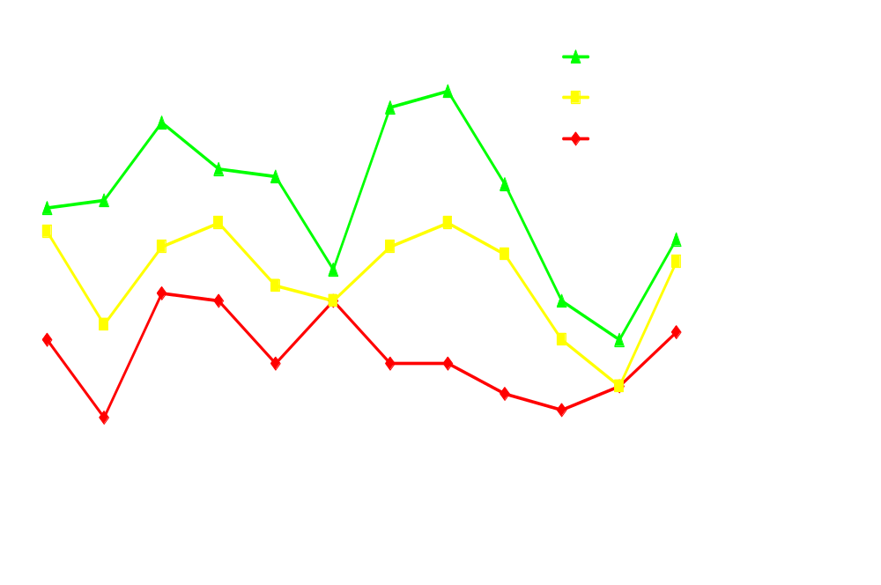
GRAPHS
Too detailed !

Slide 14
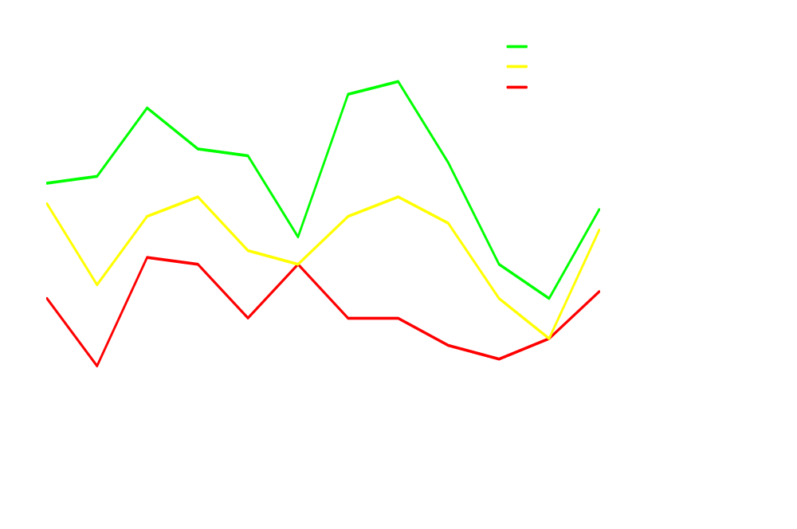
Much Simpler

Slide 15






KEEP IT SIMPLE (PICTURE)
Art work may distract your audience
Artistry does not substitute for content

Slide 16




KEEP IT SIMPLE (SOUND)
Sound effects may distract too
Use sound only when necessary

Slide 17
KEEP IT SIMPLE (TRANSITION)
This transition is annoying, not enhancing
"Appear" and "Disappear" are better

Slide 18
KEEP IT SIMPLE (ANIMATION)
2 m
Too distracting !

Slide 19
KEEP IT SIMPLE (ANIMATION)
2 m
Simple & to the point

Slide 20
MAKE IT CLEAR

Slide 21
MAKE IT CLEAR (CAPITALISATION)
ALL CAPITAL LETTERS ARE DIFFICULT TO READ
Upper and lower case letters are easier

Slide 22
MAKE IT CLEAR (FONTS)
Sanserif Z
Serif Z
clear
busy

Slide 23
MAKE IT CLEAR (FONTS)
Serif fonts are difficult to read on screen
Sanserif fonts are clearer
Italics are difficult to read on screen
Normal or bold fonts are clearer
Underlines may signify hyperlinks
Instead, use colours to emphasise other details

Slide 24
MAKE IT CLEAR (NUMBERS)
Use numbers for lists with sequence
For example:
How to put an elephant into a fridge?
1. Open the door of the fridge
2. Put the elephant in
3. Close the door

Slide 25
MAKE IT CLEAR (NUMBERS)
How to put a giraffe into a fridge?
1. Open the door of the fridge
2. Take out the elephant
3. Put the giraffe in
4. Close the door

Slide 26
MAKE IT CLEAR (BULLETS)
Use bullets to show a list without
Priority
Sequence
Hierarchy, …..

Slide 27
PARALLELISM
Use the same form when starting a list
How to put a giraffe into a fridge?
1. Open the door of the fridge
2. Take out the elephant
3. Putting the giraffe in
4. Close the door

Slide 28
MAKE IT CLEAR (COLOURS)
Use contrasting colours
Light on dark vs dark on light
Use complementary colours

Slide 29
MAKE IT CLEAR (CONTRAST)
Use contrasting colours
Light on dark vs dark on light
Use complementary colours
high contrast
low contrast

Slide 30
MAKE IT CLEAR (CONTRAST)
Use contrasting colours
Light on dark vs dark on light
Use complementary colours
This is light on dark

Slide 31
MAKE IT CLEAR (CONTRAST)
Use contrasting colours
Light on dark vs dark on light
Use complementary colours
This is dark on light

Slide 32
MAKE IT CLEAR (COMPLEMENT)
Use contrasting colours
Light on dark vs dark on light
Use complementary colours
These colours do not complement

Slide 33
MAKE IT CLEAR (COMPLEMENT)
Use contrasting colours
Light on dark vs dark on light
Use complementary colours
These colours complement

Slide 34

MAKE IT CLEAR (SIZE)
Size implies importance

Slide 35
MAKE IT CLEAR (SIZE)
Size implies importance

Slide 36
MAKE IT CLEAR (FOCAL POINTS)
Focal points direct attention

Slide 37
MAKE IT CLEAR (FOCAL POINTS)
Focal points direct attention

Slide 38
BE PROGRESSIVE

Slide 39
TYPES OF INSTRUCTIONAL TOOLS
Discovery
Learning
Individual
Constructive
Tools
Social
Constructive
Tools
Too many in one go!
Guided
Inquiry
Informational Tools
Mode of Instruction
Individual
Instructive
Tools
Social
Communicative
Tools
Direct
Instruction
Individual
Pair
Group
Complexity of Interactions

Slide 40
TYPES OF INSTRUCTIONAL TOOLS
Discovery
Learning
Individual
Constructive
Tools
Social
Constructive
Tools
Guided
Inquiry
Informational Tools
Mode of Instruction
Progressive & thus focused
Individual
Instructive
Tools
Social
Communicative
Tools
Direct
Instruction
Individual
Pair
Group
Complexity of Interactions

Slide 41

UNDERSTANDING TECHNOLOGY
Mouse
I/O Error
Main Storage
CPU
Function key
Too many & not focused
User interface
Software
Debugger
Floppy disk
Backup system

Slide 42
UNDERSTANDING TECHNOLOGY
Mouse
I/O Error
Main Storage
CPU
Function key
Progressive & thus focused
User interface
Software
Debugger
Floppy disk
Backup system

Slide 43
BE CONSISTENT

Slide 44
BE CONSISTENT
Differences draw attention
Differences may imply importance
Use surprises to attract not distract

Slide 45
BE CONSISTENT
Differences draw attention
Differences may imply importance
Use surprises to attract not distract
This tick draws attention

Slide 46
BE CONSISTENT
Differences draw attention
Differences may imply importance
Use surprises to attract not distract
These differences distract!

Slide 47
BE CONSISTENT
Differences draw attention
Differences may imply importance
Use surprises to attract not distract
_x001d_
This implies importance

Slide 48
BE CONSISTENT
Differences draw attention
Differences may imply importance
Use surprises to attract not distract
Confusing differences!

Slide 49
BE CONSISTENT
Differences draw attention
Differences may imply importance
Use surprises to attract not distract
This surprise attracts

Slide 50
BE CONSISTENT
Differences draw attention
Differences may imply importance
Use surprises to attract not distract
These distract!

Slide 51
IN SUMMARY
Big
Simple
Clear
Progressive
Consistent

Slide 52
SOME FINAL WORDS

Slide 53
WHEN CREATING
Text to support the communication
Pictures to simplify complex concepts
Animations for complex relationships
Visuals to support, not to distract
Sounds only when absolutely necessary
Think about the people in the back of the room when creating slides

Slide 54
WHEN PRESENTING
Speak loudly and clearly with fluctuation
Direct your words to all aspects of the room
Maintain eye contact with your audience
Ask questions of your audience
  (if applicable)
Don’t read the slides word-for-word, use them for reference

Slide 55
CLOSING REMARKS
Practice your presentation before a neutral audience
  Ask for feedback
Be particular about the time allotted for presentation
Leave time for questions

Slide 56
THANK YOU !

